Slide 1





SMART HOSTEL MANAGEMENT & SECURITY
SUBMITTED BY-
AMAN SINGH
MAYANK GUPTA
KARTIK AGRAWAL
ANIMESH RAGHUVANSHI
SUBMITTED TO-
MR. AMIR KHAN
(Technical Trainer)

Slide 2

Contents
Abstract
Introduction
Requirement Gathering and Analysis
Methodology Used
Hardware and Software Requirements.
System Design
Conclusion
References

Slide 3

Abstract
As the name specifies “SMART HOSTEL MANAGEMENT AND SECURITY” is project developed for managing various activities in the hostel. For the past few years the number of educational institutions is increasing rapidly. Thereby the number of hostels is also increasing for the accommodation of the students studying in this institution. And hence there is a lot of strain on the person who are running the hostel and software’s are not usually used in this context. This particular project deals with the problems on managing a hostel and avoids the problems which occur when carried manually.
Identification of the drawbacks of the existing system leads to the development of IoT based hostel management system that will be compatible to the existing system with the system which is more user friendly and more sensors oriented.
We can improve the efficiency of the system, thus overcome the drawbacks of the existing hostel management and security. Less human error, Strength and strain of manual labour can be reduced, High security, Easy to handle, Easy record keeping, Backup data can be easily generated.

Slide 4

Introduction
Internet of Things (IoT) is the networking of physical objects that contain electronics embedded within their architecture in order to communicate and sense interactions amongst each other or with respect to the external environment. In the upcoming years, IoT-based technology will offer advanced levels of services and practically change the way people lead their daily lives. Advancements in medicine, power, gene therapies, agriculture, smart cities, and smart homes are just a very few of the categorical examples where IoT is strongly established.
There are four main components used in IoT:
1. Low-power embedded systems
2. Cloud computing
3. Availability of big data
4. Networking connection

Slide 5

Modules
Ultrasonic sensor with LED.(HC-SR04)
Smoke Sensor with Buzzer and LED.(MQ-2)
Temperature and Humidity Sensor.(DHT-11)
Servo Motor
Controlling LED with Blynk app.

Slide 6

Existing System
In recent times, we have seen that there has been the great amount of loss in terms of electricity wastage.In hostels we have seen that students often leave their room/hostel without viewing that they have not switch off the fans and lights. The current hostel system does not take care of some of the very important aspects which is needed to be taken care of. In this series, the first issue with current ongoing system is improper utilization of electricity, students often in hurry to attend classes, left the power switch on which leads to wastage of the electricity. Fans, CFLs, Cooler etc. remain on even if there is nobody in the room. This leads to improper power consumption.
In addition to this sometimes students also leave the gate of their room open. This may lead to theft
activities of the belongings of the inmates. After this one had to go to the warden to look for the CCTV footage to find the culprit, the effect of which is seen among the students as they are always worried.

Slide 7

Disadvantages
Time consuming
Inaccuracy of data
More human error
Low security
Difficult to handle
Difficult to update data.

Slide 8

Proposed System
In this framework, we are proposing a deployment of an infrared sensor which can detect the presence of the person in the room. If the person is not available in the room, then appliances will be switched off automatically.
Also, we can deploy a sensor at the entrance which can detect the entry and exit of a person based on which we can predict whether a person is present in the room or not.
We will also deploy a temperature sensor which will detect the room temperature and appliances like fan, cooler, AC etc. will be adjusted based on user requirement.

Slide 9

Advantages
1. Reduce the excess wastage of electricity in hostels.
2. Increases the security of students from theft.
3. Save the hostel inmates from fire accidents.
4. Prevent students from smoking activities.

Slide 10

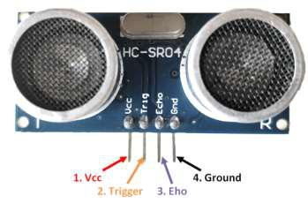
FunctionSpecification
Ultrasonic Sensor:
•Operating voltage: +5V
•Theoretical Measuring Distance: 2cm to 450cm
•Practical Measuring Distance: 2cm to 80cm
•Accuracy: 3mm
•Measuring angle covered: <15°
•Operating Current: <15mA
•Operating Frequency: 40Hz

Slide 11

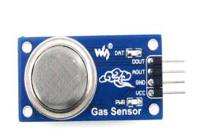
Function Specification
Specifications:
Wide range sensitivity to combustible gas.
Better sensitivity to Propane, LPG and Hydrogen
Low cost and better life
Drive circuit is simple.
Sensor Type : Semiconductor
Concentration : 300-10000ppm ( Combustible gas)
Supply voltage =5v
MQ-2 SENSOR

Slide 12
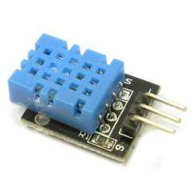
Function Specification
Specifications:
•Supply Voltage: +5 V
•Temperature range :0-50 °C error of ± 2 °C
•Humidity :20-90% RH ± 5% RH error
•Interface: Digital
DHT-11 SENSOR:

Slide 13
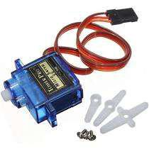
Function Specification
Servo motor has three pins for its operation as:
•+VCC (RED)
- Connect +VCC supply to this pin. For SG90 Micro Servo it is 4.8 V (~5V).
•Ground (BROWN)
- Connect Ground to this pin.
•Control Signal (ORANGE)
- Connect PWM of 20ms (50 Hz) period to this pin.
Servo Motor:

Slide 14
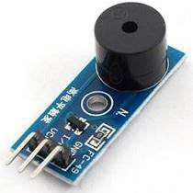
Function Specification
Features:
1)Use an S8550 PNP transistor for drive
2)Convenient control by program
3)Working voltage: 3.3 - 5V; PCB size: 2.0 x 2.0 cm
4)With power light and indicator of digital signal output
Buzzer:

Slide 15
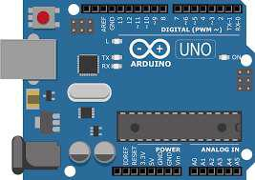
Function Specification
The features of Arduino Uno ATmega328 includes the following.
•The operating voltage is 5V.
The recommended input voltage will range from 7v to 12V
•The input voltage ranges from 6v to 20V
•Digital input/output pins are 14
•Analog i/p pins are 6
•DC Current for each input/output pin is 40 mA
•DC Current for 3.3V Pin is 50 mA
•Flash Memory is 32 KB
•SRAM is 2 KB
•EEPROM is 1 KB
•CLK Speed is 16 MHz
Arduino::

Slide 16
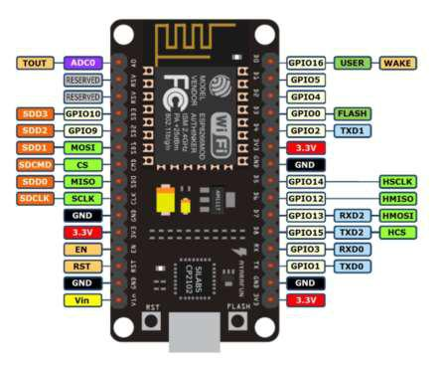
Function Specification
NodeMCU V3 Features:
•Open-source
•Arduino-like hardware
•Status LED
•Micro USB port
•Reset/Flash buttons
•Interactive and Programmable
•Low cost
•ESP8266 with inbuilt Wi-Fi
•USB to UART converter
•GPIO pins
Node MCU

Slide 17
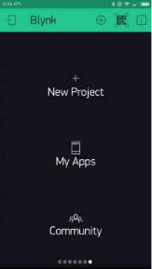
Function Specification
Blynk is a Platform with IOS and Android apps to control Arduino, Raspberry Pi and the likes over the Internet. It’s a digital dashboard where you can build a graphic interface for your project by simply dragging and dropping widgets.
Blynk App:

Slide 18
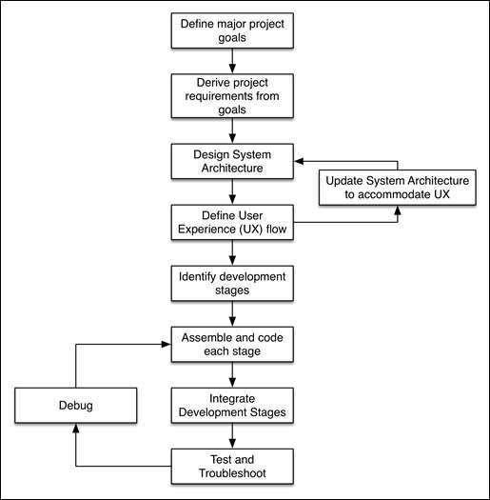
Methodology Used
The process of developing a complex product that tightly couples hardware devices with high –level software services requires an additional level of planning. For this project, we will exercise a proper product development approach to help you get familiar with the process of creating real –world hardware projects. This method can then be used to plan your own projects and take them to the next level. The following diagram describes a typical prototype development process, which always begins by defining the major goals that you want to achieve with your product:

Slide 19

H a r d w a r e a n d S o f t w a r e r e q u i r e m e n t s.
1.3-Hardware and Software Requirement:
Software Specification:
• Technology Implemented : IOT
• Language Used : Embedded C
• Database : Cloud
• User Interface Design : Arduino IDE, Blynk App
• Web Browser : Chrome, Explorer, Firefox etc.
Hardware Requirements:
• Processor : Core i5
• Operating System : Windows
• RAM : 4GB
• Hardware Devices : Node MCU, Servo Motor,MQ2 Sensor, Ultrasonic
Sensor, DHT11 Sensor, Buzzer, Arduino UNO, Wires
• Hard disk : 1 TB, Graphic Card
• Display : Laptop Screen

Slide 20

System Design

Slide 21
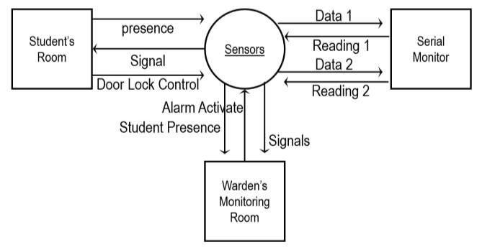
Data flow diagram as a Whole.
Hostel
Database

Slide 22

Data Flow Diagram Level 1
Student
Verify data
Application form
Hostel Management System
Admin
Allotment
Confirm

Slide 23

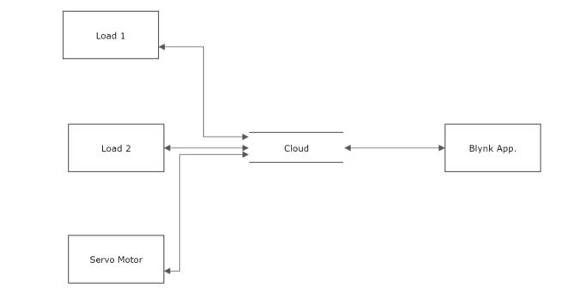
Data Flow Diagram For Blynk App.
Application Varification
Login

Slide 24

Conclusion
Now we have implemented the project on a small basis but we can expand it on a large basis in which we can use multiple sensor to automate whole hostel. Such that if we have left tap open then it will automatically close it. We are using pyro electric on a small basis but it can be extended and can be used all over the hostel and mess which will convert pressure into electricity. This will lead us to generate power and help us to save money.
All the functionality can be extended in office, dispensary, gym, playgrounds, common room, class rooms etc. We will also see the maintenance in the addition of the above project and will add module with the same after new problems will come.
Seeing the development of the project in the future, we will try to add image processing as new emerging technology in our project and it will definitely add a boost-up to this idea.

Slide 25

References
1. https://www.geeksforgeeks.org/
2. https://www.researchgate.net/
3. Wikipedia
4.https://subscription.packtpub.com

Slide 26

Thank You

